Slide 1





Group 11
Expense Manager
Gestão de Projeto de software
Instituto Superior de Engenharia Informática

Slide 2


Introduction
Product
Project management
Risk plan
Topics
Quality
DevOps
Global analysis and conclusions
Lessons learned
Individual analysis
Questions

Slide 3
Introduction

Slide 4

Artur Yurchuk
2021130221
Product Owner
Lara Bizarro 2021130066
The Team
Scrum Master
Francisco Costa 2021146317
Developer
Joana Ferrão 2020131638
Developer
Ana Silva 2021154586
Developer

Slide 5
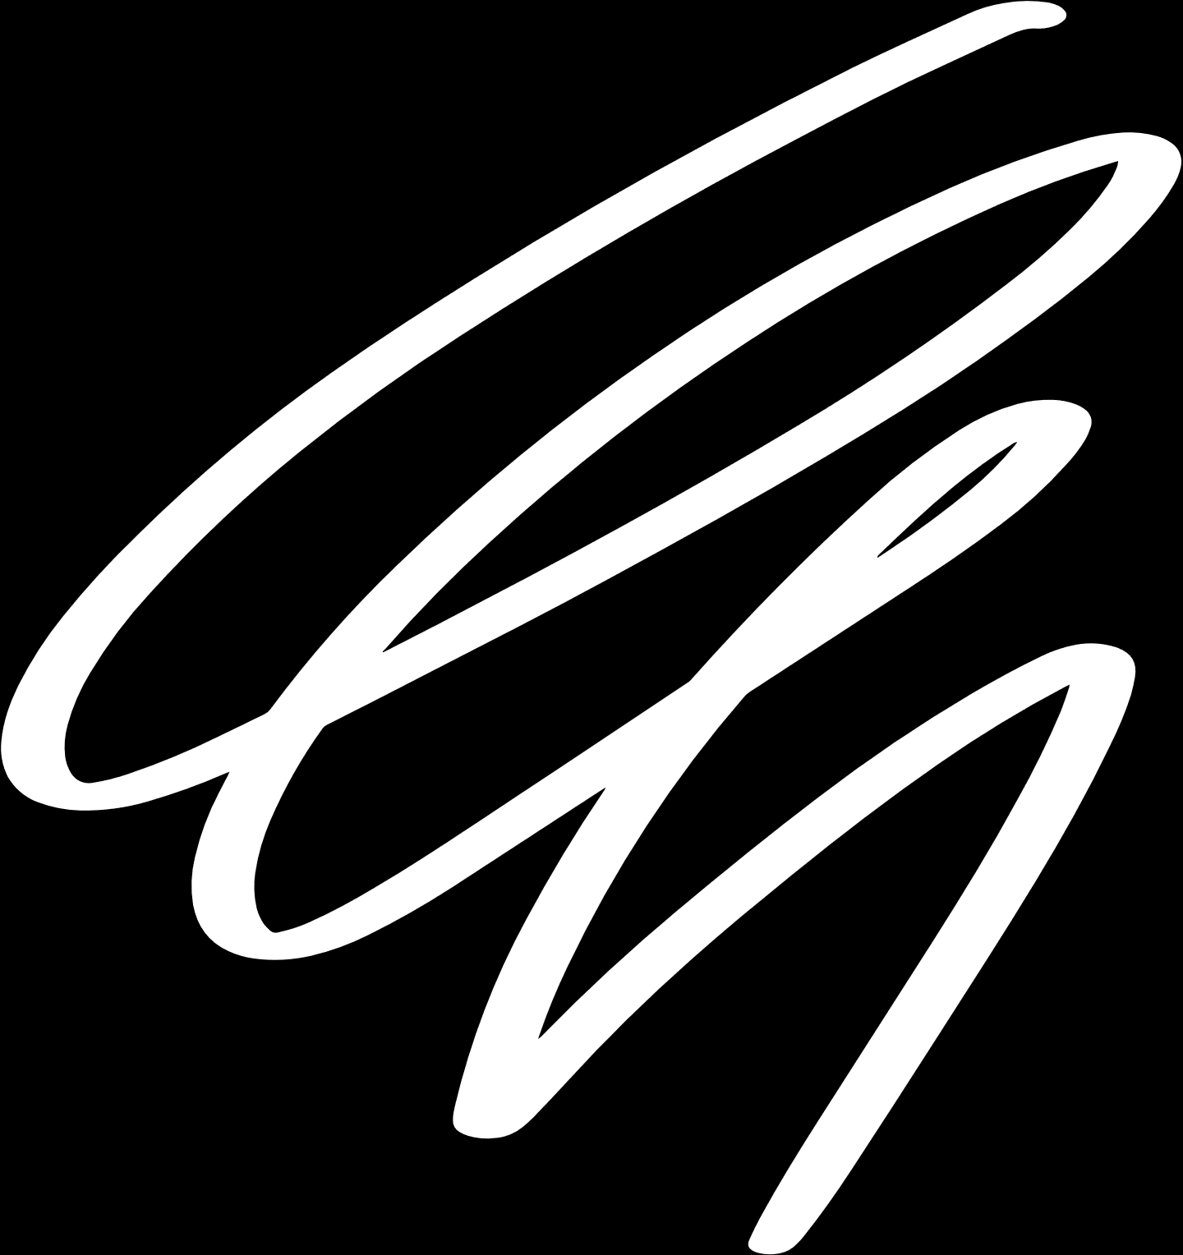
Vision
We see Expense Manager as a catalyst for change, helping users take control of their money, reducing financial stress and helping to create and achieve user goals, by having expenses summaries, analyses and tracking, allowing to establish monthly budgets/limits.
Project goals
Develop a User-Friendly Expense Tracking System
Categorize, Analyze and Tracking expenses
Set and Track Objectives
Back to Topics

Slide 6
Product

Slide 7

[US 1] - As a student, I want to be able to track my daily expenses, so that I can maintain an accurate record of my personal finances.
[US 2] - As a user, I want to manage categories so that I can organize my expenses according to different types.
[US 3] - As a student, I want to access expenses so that I can view all my recorded expenses.
Users Stories
[US 4] - As a student, I want to see reports so that I can analyze them.
[US 5] - As a user, I want to reserve amounts for future expenses so that I can plan my budget.
[US 6] - As a user, I want to set goals so that I can work for a specific objective.
[US 7] - As a user, I want to see the monthly budget so that I can make adjustments as needed.
1

Slide 8
[US 8] - As a user, I want to extract data from reports in PDF and Excel, so that I can share and analyze my expenses.
[US 9] - As a student, I want to reset the monthly budget, so that I can start a new period of financial control.
[US 10] - As a student, I want to view the transaction history so that I can review my past financial activities.
Users Stories
[US 11] - As a student, I want to view the use of my academic scholarship so that I can keep track of it’s usage.
[US 12] - As a user, I want to view expenses by category, so that I can understand in which categories I spend the most money.
[US 13] - As a working student, I want to add money to my budget, so that I can keep the budget updated.
[US 14] - As a student, I want to track automatically reserved amounts, so that I can add recurrent expenses and categories
2

Slide 9


Sprint 0
Goals: Plan the project, create an action plan and present the project to the client.
US: -----
Sprint 1
Planning
&
Delivered
Goals: User Interface, create the simplest methods for tracking and managing expenses, monthly budget and adding and categorize expenses.
US: 1, 2, 7, 10, 13
Sprint 2
Goals: Monthly budget reseting, entry display, transaction history, allow goal setting, amount reservation and manage scholarship.
US: 3, 5, 6, 7, 9, 11, 12, 13
Sprint 3
Goals: Add recurrent expenses, notifications for goals or low funds, do all corrections needed
US: 1, 4, 6, 7, 10, 11, 13, 14

Slide 10
Release 1
Goals:
Track, Categorize and Analise expenses;
Expense Summary;
Release
plan
Release 2
Goals:
Have a functional app with the missing features (Notifications).
Back to Topics

Slide 11
Project Management

Slide 12


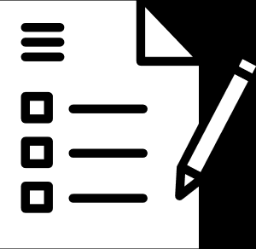


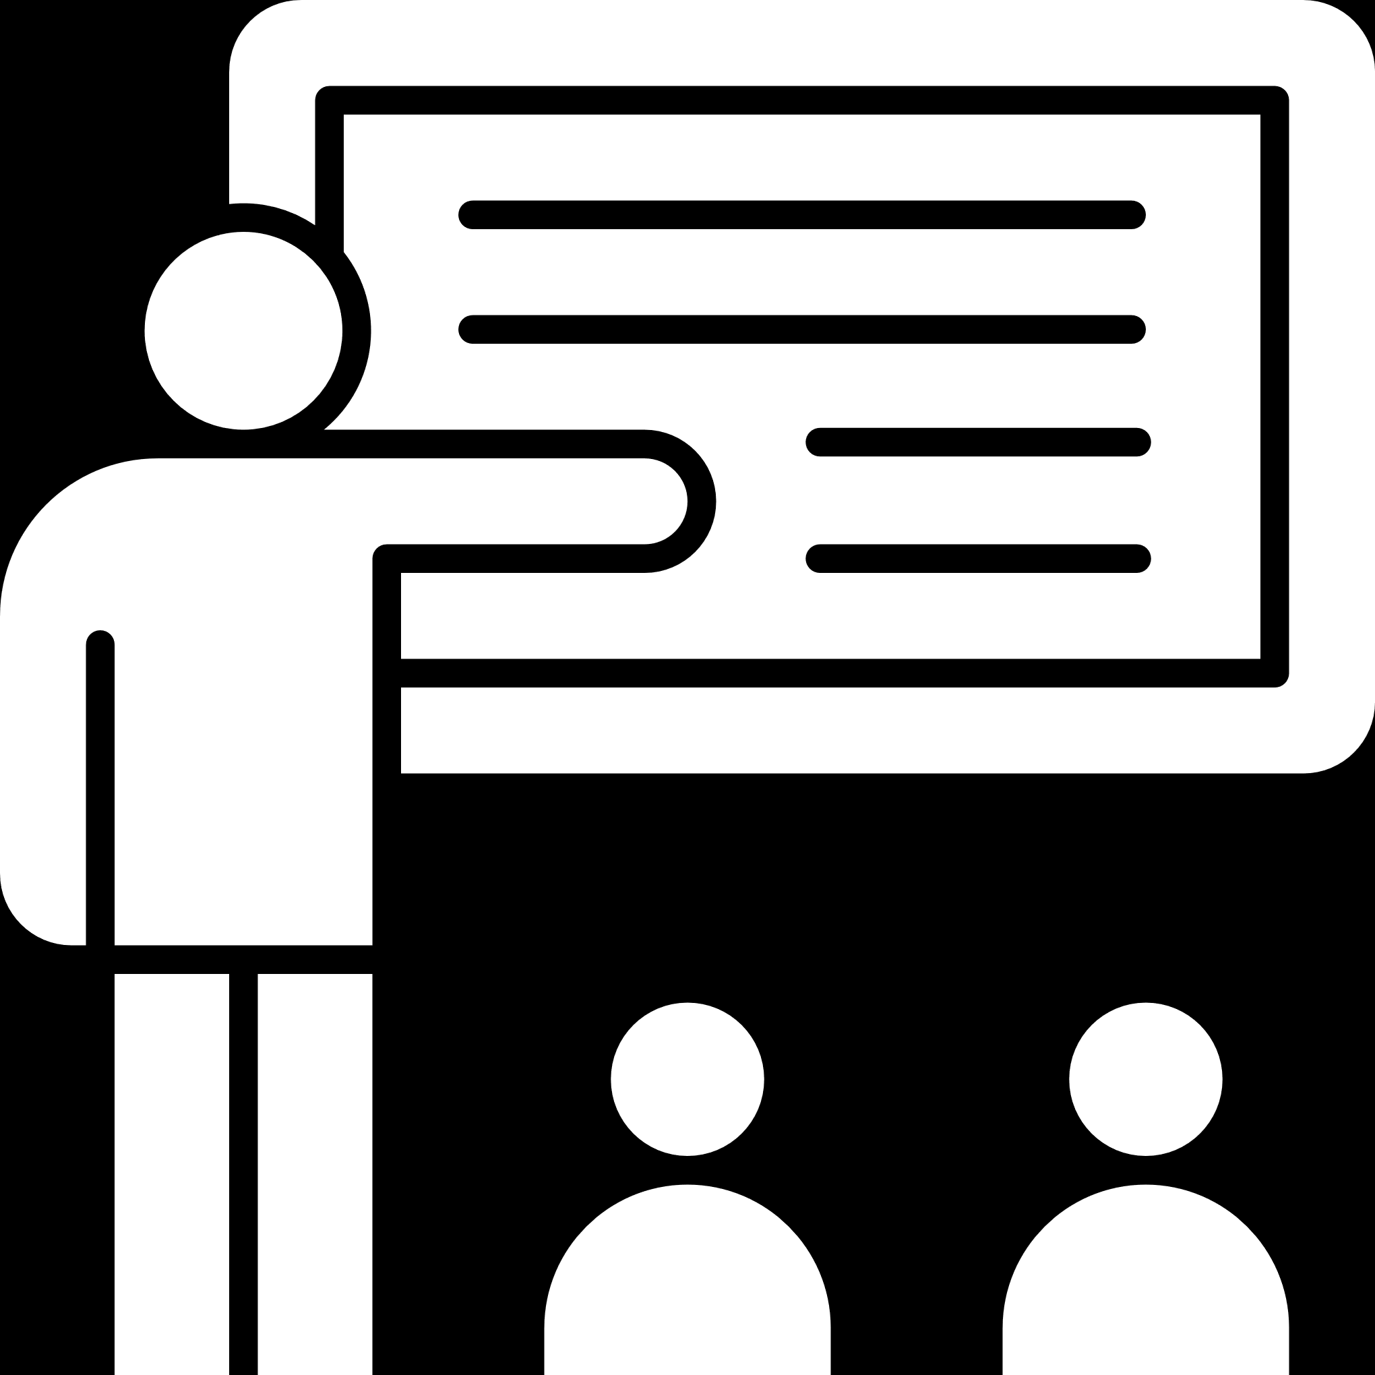


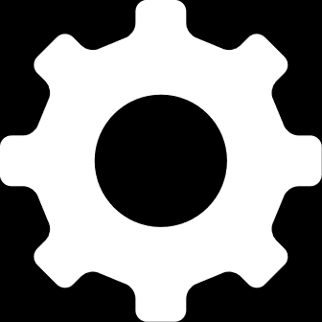



Project Lifecycle
Plan
Close
Present
to client
Present
to client
Execute &
Controlling
Test

Slide 13
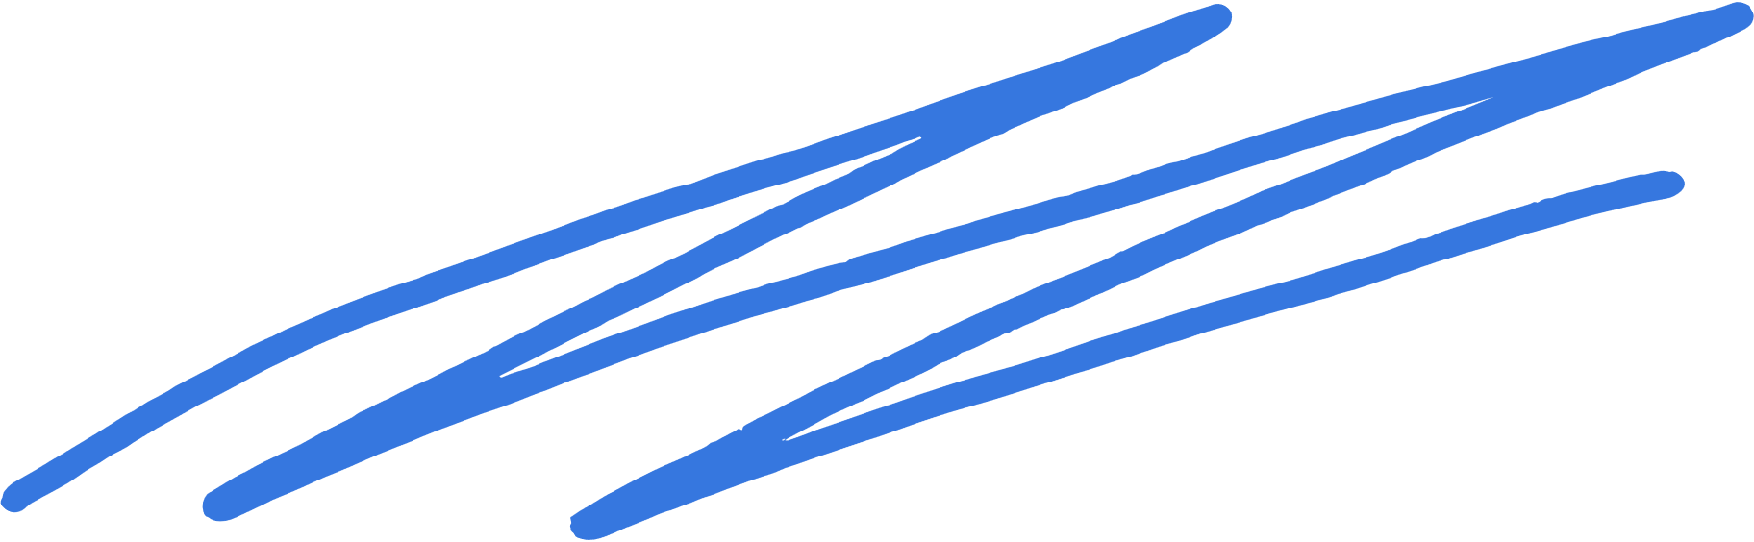

Budget & Effort
Sprint 1
Budget: 38 hrs 30 min
Spent: 35 hrs 50 min
Sprint 2
Budget: 37 hrs 40 min
Spent: 33 hrs 40 min
Sprint 3
Budget: 37 hrs 40 min
Spent: 37 hrs 35 min
Back to Topics

Slide 14
Risk Plan

Slide 15
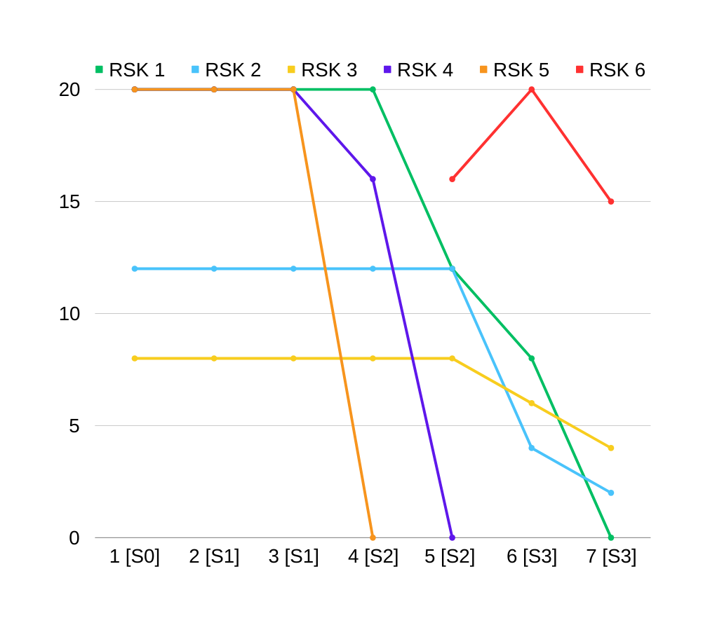
[RSK 1] The team doesn't have any experience in this type of project, this can lead to delays in goals due to poorly calculated time estimates or communication failures.
Evolution
[RSK 2] There are constant simultaneous changes to the project, this can cause conflicts, complications, or delays on the project.
[RSK 3] Considering that the group members are not professionals in this area, they may write code that uses excessive resources and encounter more bugs. This will force us to spend more time than necessary, leading to possible delays.
[RSK 4] The group's members are inexperienced in security and privacy. As we intend to work with sensitive information, we have a high risk of data or privacy breaches, which could jeopardize the fidelity of our software.
[RSK 5] We have a limited amount of time, so we might not be able to finish all the features that we promised.
[RSK 6] Misunderstandings between the team and the client's expectations, might lead to project delays, compromised client satisfaction.

Slide 16
Quality

Slide 17

 | Unit Test | Integration Test | Acceptance Criteria | Comments
Sprint 1 | Done | Done | Done | All required testing phases were completed, including unit tests, integration tests, and acceptance tests, contributing to the overall quality assurance of the system.
Sprint 2 | Done | Done | Not well done | All required testing phases were completed, including unit tests, integration tests, and acceptance tests, contributing to the overall quality assurance of the system.
Sprint 3 | Done | Done | Done | All required testing phases were completed, including unit tests, integration tests, and acceptance tests, contributing to the overall quality assurance of the system.
Back to Topics

Slide 18
DevOps

Slide 19
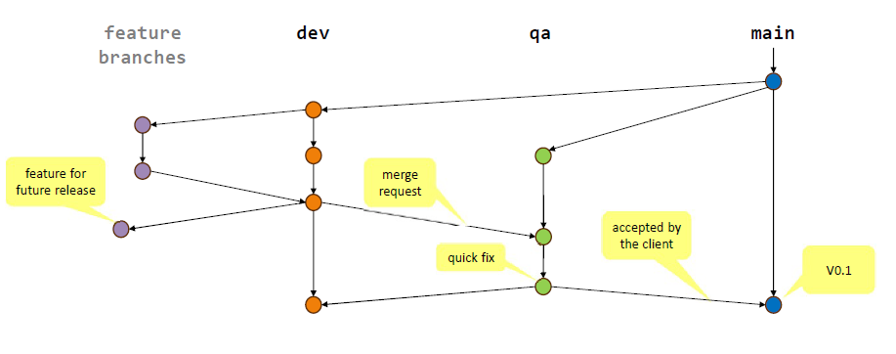
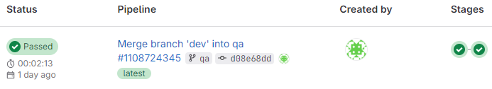
Git Workflow
CI/CD pipeline
Back to Topics

Slide 20
Global analysis
&
Conclusions

Slide 21
Global analysis
90% of user stories were completed as desired
Sprint objectives fulfilled, not always in line with the client's vision
Release objectives fulfilled
Project objective fulfilled
Risks were reduced

Slide 22
Conclusions
Initially, we felt a bit disoriented, but eventually, we established a solid work balance by leveraging the strengths of each team member.
Effective communication.
There was always someone accessible to help.
Good workflow.
It took some time to grasp the client's expectations, persistent communication ultimately enabled us to accurately capture and reproduce his vision.

Slide 23
Lessons learned

Slide 24

Never assume what the client wishes
Constantly check with the client
Show all the mockups to the client and wait for him to approve
Rushing through acceptance testing can result in the oversight
of potential bugs or issues.
It is crucial to prioritize specific features.
Back to Topics

Slide 25
Individual analysis

Slide 26
Ana Sofia
Main individual contributions:
Documentation (ReadMe maintenance)
Participation on team results:
Acceptance Criteria (Creation and verification)
Participation on weekly meetings
Documentation maintenance
Perception of the team performance:
Great communication
Continuous meetings
Available members
Great team-work spirit

Slide 27
Artur Yurchuk
Main individual contributions:
Transaction history (UI, filters and logic)
Add expenses and entries (Logic)
Statistics (Logic and verifications)
Add envelopes and categories (Logic and checks)
Participation on team results:
Goals (Envelope automatic distribution)
Automatic distribution
Home page maintenance
Documentation maintenance
Hold weekly meetings
Perception of the team performance:
At first a little lost coding but then a good balance
Good communication
Every week of meetings
Some members always available
Good work-flow

Slide 28
Francisco Costa
Main individual contributions:
Transaction history (Setup)
Database (Logic & Management)
Budget features (UI, methods)
Participation on team results:
Database & History management
Documentation maintenance
Hold weekly meetings
Perception of the team performance:
Initially slow and confused but with time learned to adapt and work together
Good communication
Weekly of meetings
Members always available
Members always happy to help
Good work-flow

Slide 29
Joana Ferrão
Main individual contributions:
Goals (Setup & maintenance)
Envelope automatic distribution
Notifications (Setup & maintenance)
Automatic actions (money distribution, payments, etc)
Participation on team results:
Envelopes (Reoccurring expenses & Automatic distribution)
Home page maintenance
Pop-up setup
Documentation maintenance
Perception of the team performance:
Great balance of skills
Very good communication
Continuous meetings
Available members
Good work-flow
Team-work spirit

Slide 30
Lara Bizarro
Main individual contributions:
User Interface (Creation & maintenance)
Homepage (Setup)
Documentation (Creation & maintenance)
Acceptance Criteria
Gitlab (maintenance)
Participation on team results:
Kept GitLab updated
UI maintenance
Hold weekly meetings
Monthly reset setup
Documentation maintenance
Most of acceptance criteria
Perception of the team performance:
Great balance of skills
Effective communication
Managed to find balance
Some members always available to help
Regular check-ins

Slide 31
Questions
Back to Topics

